Slide 1
Chapter 4
How to use CSS to format the elements of a web page

Slide 2
Objectives
Applied
Given an HTML document, create a CSS style sheet for formatting the web page using any of the types of selectors or rules that are presented in this chapter.
Given an HTML document with one or more CSS style sheets applied to it, use the developer tools in your browser to inspect the styles.
Given a selector in the CSS for an HTML document, describe what the selector applies to.
Knowledge
Describe three ways to include CSS in a web page.
Explain why it’s usually best to use an external style sheet for formatting a page.

Slide 3
Objectives (continued)
Explain the purpose of a normalize.css style sheet.
Distinguish between absolute and relative units of measurement.
Describe three ways to specify color in CSS, and describe how CSS3 expands upon that.
Describe these types of selectors: universal, type, id, class, descendant, child, sibling, pseudo-class, and pseudo-element.
Describe one accessibility guideline for using pseudo-class selectors.
Explain how !important rules and specificity are used in the cascade order for applying style rules.
Describe these properties for styling fonts: font-family, font-style, font-weight, font-size, and line-height.
Describe these properties for formatting text: text-indent, text-align, text-decoration, and text-shadow.

Slide 4
Three ways to provide styles
Use an external style sheet by coding a link element in the head section
<link rel="stylesheet" href="styles/main.css">
Embed the styles in the head section
<style>
body {
font-family: Arial, Helvetica, sans-serif;
font-size: 100%; }
h1 { font-size: 250%; }
</style>
Use the style attribute to apply styles to a single element
<h1 style="font-size: 500%; color: red;">Valley Town Hall</h1>

Slide 5
The sequence in which the provided styles are applied
Styles from an external style sheet
Embedded styles
Inline styles

Slide 6
A head element that includes two style sheets
<head>
<title>San Joaquin Valley Town Hall</title>
<link rel="stylesheet" href="../styles/main.css">
<link rel="stylesheet" href="../styles/speaker.css">
</head>
The sequence in which the styles are applied
From the first external style sheet to the last
From the first embedded style sheet to the last
Inline Styles

Slide 7
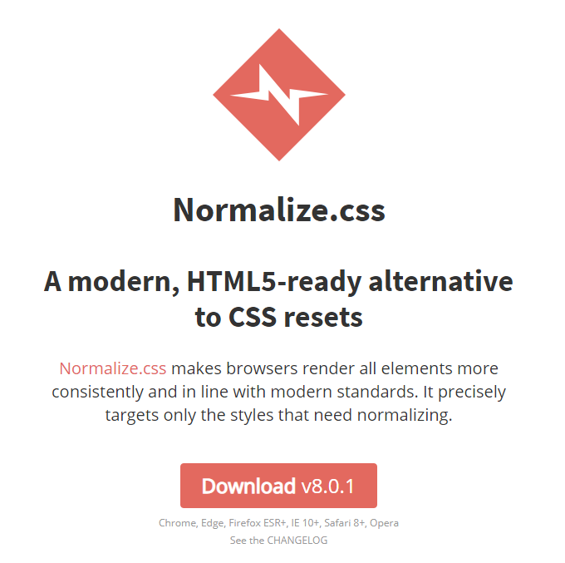
http://necolas.github.io/normalize.css/

Slide 8
How to download and use normalize.css
What the normalize.css style sheet does
Normalize.css makes minor adjustments to browser defaults so all browsers render HTML elements the same way.
(Used to change the font-family to sans-serif in older versions.)
http://necolas.github.io/normalize.css/
Open a browser, browse to the URL shown above, and click the Download button.
Save the normalize.css file to your web server.
Once you save the normalize.css file to your website, you can code a link element for it in each page.
<link rel="stylesheet" href="styles/normalize.css">

Slide 9
Common units of measure
px
pt
em
rem
%
vh
vw
A pixel represents a single dot on a screen.
A point is 1/72 of an inch.
An em is height of an uppercase M in the font of the current element.
A rem is height of an uppercase M in the font of the <html> element.
Relative to the current value.
A vh is 1% of the viewport's current height.
A vw is 1% of the viewport's current width.

Slide 10
All measurements are relative!
px
pt
em
rem
%
vh
vw
Relative to screen density. (px / density = pt)
Relative to screen density. (pt * density = px)
Relative to font-family and font-size of current element.
Relative to font-family and font-size of the <html> element.
Relative to the current value.
Relative to viewport's current height.
Relative to viewport's current width.

Slide 11
The HTML for a web page that will have borders
<body>
<header>
<h1>San Joaquin Valley Town Hall</h1>
</header>
<main>
<p>Welcome to San Joaquin Valley Town Hall. We have some fascinating speakers for you this season!</p>
</main>
</body>
book_examples/ch04/03_measurements.html

Slide 12
CSS that uses relative units of measure with a fixed border
body {
font-size: 100%;
margin-left: 2em;
margin-right: 2em; }
header {
padding-bottom: .75em;
border-bottom: 3px solid black;
margin-bottom: 0; }
h1 {
font-size: 200%;
margin-bottom: 0; }
book_examples/ch04/03_measurements.html

Slide 13

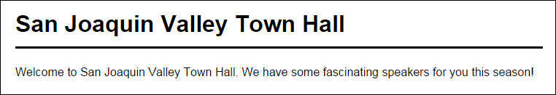
The web page with borders in a web browser
Without CSS
With CSS
book_examples/ch04/03_measurements.html

Slide 14
Recommended Practices
Use the following units for the listed purposes.
px
root font-size, border, outline
rem
font-size, margin, padding, width, height
vh / vw
page layout

Slide 15
Three ways to specify colors
With a color name
color: red;
With an RGB (red-green-blue) value
color: rgb(100%, 40%, 20%);
color: rgb(255, 102, 51); /* 0 to 255 */
With an RGB value that uses hexadecimal numbers
color: #ffffff; /* This color is white */
color: #000000; /* This color is black */
color: #ff0000; /* This color is red */
"Most graphic designers use hexadecimal or hex values to specify an RGB value because that lets them choose from over 16 million colors." (p. 131)

Slide 16
CSS that uses hexadecimal values for colors
body {
font-size: 100%;
margin-left: 2em;
background-color: #FFFFCC; }
h1 {
font-size: 200%;
color: #0000FF; }
book_examples/ch04/04_colors.html

Slide 17
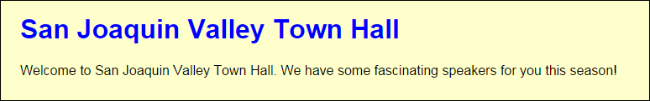
The hex colors in a web browser
Without CSS
With CSS
book_examples/ch04/04_colors.html

Slide 18
Accessibility guideline for colors
Remember the visually-impaired.
Dark text on a light background is easy to read.
Black type on a white background is easiest to read.
You can also flip this and put light text on a dark background. (Many users, especially developers, prefer this to reduce eye strain.)

Slide 19
Other ways to specify colors with CSS3
The syntax for RGBA colors
rgba(red%, green%, blue%, opacity-value)
The syntax for HSL and HSLA colors
hsl(hue-degrees, saturation%, lightness%)
hsla(hue-degrees, saturation%, lightness%, opacity-value)
The CSS3 values for colors
opacity-value
hue-degrees
saturation%
lightness%

Slide 20
Examples of CSS3 colors
/* semi-transparent blue */
h1 { color: rgba(0, 0, 255, .2) }
/* dark green */
h1 { color: hsl(120, 100%, 25%) }
/* pastel green */ }
h1 { color: hsl(120, 75%, 75%) }
/* semi-transparent solid blue */
h1 { color: hsla(240, 100%, 50%, 0.5) }
book_examples/ch04/05_css3colors.html

Slide 21

The CSS3 colors in a browser
rgba(0, 0, 255, .2)
hsl(120, 100%, 25%)
hsl(120, 75%, 75%)
hsla(240, 100%, 50%, 0.5)
book_examples/ch04/05_css3colors.html

Slide 22
HTML that can be selected by element type, id, or class
<main>
<h1>This Season's Speaker Lineup</h1>
<p class="blue">October: Jeffrey Toobin</p>
<p class="blue">November: Andrew Ross Sorkin</p>
</main>
<footer>
<p id="copyright" class="blue right">Copyright 2018</p>
</footer>
book_examples/ch04/06_selectors.html

Slide 23
CSS style rules by element type, id, and class
All elements
* { margin: .5em 1em; }
Elements by type
main { border: 2px solid black; padding: 1em; }
h1 { font-family: Arial, sans-serif; }
p { margin-left: 3em; }
One element by ID
#copyright { font-size: 80%; }
Elements by class
.blue { color: blue; }
.right { text-align: right; }
book_examples/ch04/06_selectors.html

Slide 24

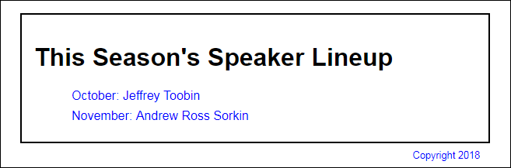
The elements displayed in a browser
Without CSS
With CSS
book_examples/ch04/06_selectors.html

Slide 25
HTML that can be selected by relationships
<main>
<h1>This Season's Town Hall speakers</h1>
<ul class="speakers">
<li>January: <a href="speakers/brancaccio.html">
David Brancaccio</a></li>
<li>February: <a href="speakers/fitzpatrick.html">
Robert Fitzpatrick</a></li>
<li>March: <a href="speakers/williams.html">
Juan Williams</a></li>
</ul>
<h2>Post-lecture luncheons</h2>
<p>Extend the excitement by going to the luncheon</p>
<p>A limited number of tickets are available.</p>
<p><em>Contact us by phone</em> at (559) 555- 1212.</p>
</main>
book_examples/ch04/07_relational.html

Slide 26
HTML Document Tree
You can think of an HTML document like a family tree.
main
h1
ul
h2
p
p
p
Relationships
em
li
li
li
parent
child
descendant
ascendent
sibling
a
a
a
book_examples/ch04/07_relational.html

Slide 27
CSS style rules with relational selectors
Descendant Selector
main li { font-size: 90%; }
ul a { color: green; }
Child Selector (aka. Direct Descendent)
main > p { font-size: 80%; }
li > a { color: green; }
Adjacent Sibling Selector
h2 + p { margin-top: .5em; }
General Sibling Selector
h2 ~ p { margin-left: 2em; }
book_examples/ch04/07_relational.html

Slide 28
Combinations of selectors
A selector for an element by both type and class
ul.speakers {
list-style-type: square;
}
Multiple selectors
h1, h2, h3 {
color: blue;
}
Multiple combined selectors
p, ul.speakers > li {
font-family: "Times New Roman", serif;
}
book_examples/ch04/08_other_selectors.html

Slide 29
Attribute selectors
All elements with href attributes
[href] {
font-size: 95%;
}
All <a> elements with href attributes
a[href] {
font-family: Arial, sans-serif;
}
All input elements with type attributes that have a value of “submit”
input[type="submit"] {
border: 1px solid black;
color: #ef9c00;
background-color: #facd8a;
}
book_examples/ch04/08_other_selectors.html

Slide 30
Common CSS pseudo-classes
A link that has not been visited.
A link that has been visited.
The active link. (Mouse button down but not released.)
The element that the mouse is hovering over. (Does not work on mobile.)
The element that currently has keyboard focus. (Works on mobile.)
:link
:visited
:active
:hover
:focus
Common CSS3 pseudo-classes
:first-child
:last-child
:only-child
Common CSS3 pseudo-elements
::first-letter
::first-line

Slide 31
HTML that can be used by pseudo-class and pseudo-element selectors
<main>
<p>Welcome to San Joaquin Valley Town Hall.</p>
<p>We have some fascinating speakers for you this season!</p>
<ul>
<li><a href="toobin.html">Jeffrey Toobin</a></li>
<li><a href="sorkin.html">Andrew Ross Sorkin</a></li>
<li><a href="chua.html">Amy Chua</a></li></ul>
</main>
book_examples/ch04/09_psuedo.html

Slide 32
The CSS for pseudo-class and pseudo-element selectors
a:link, a:visited {
color: green;
}
a:hover, a:focus {
color: fuchsia
}
main p:first-child {
font-weight: bold;
}
main p:first-child::first-letter {
font-size: 150%
}
book_examples/ch04/09_psuedo.html

Slide 33
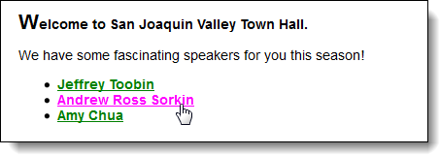
The pseudo-class and pseudo-element selectors in a browser
book_examples/ch04/09_psuedo.html

Slide 34
Accessibility guideline for :hover and :focus
Apply the same formatting to the :hover and :focus pseudo-classes for an element.
That way, those who can’t use the mouse will have the same experience as those who can.

Slide 35
The cascade order for applying CSS style rules
Inline Styles
!important rules in a style sheet
Normal rules in a style sheet
Default rules in the web browser

Slide 36
How to identify a rule as important
.highlight {
font-weight: bold !important;
}

Slide 37
If more than one style rule at a cascade level is applied to an element…
Use the style rule with the highest specificity.
If the specificity is the same for two or more style rules in a group, use the style rule that’s specified last.
How to determine the specificity of a selector
An id is the most specific.
Composite and Relational selectors are more specific than simple selectors.
A class, attribute selector, or pseudo-class selector is less specific.
An element or pseudo-element selector is least specific.

Slide 38
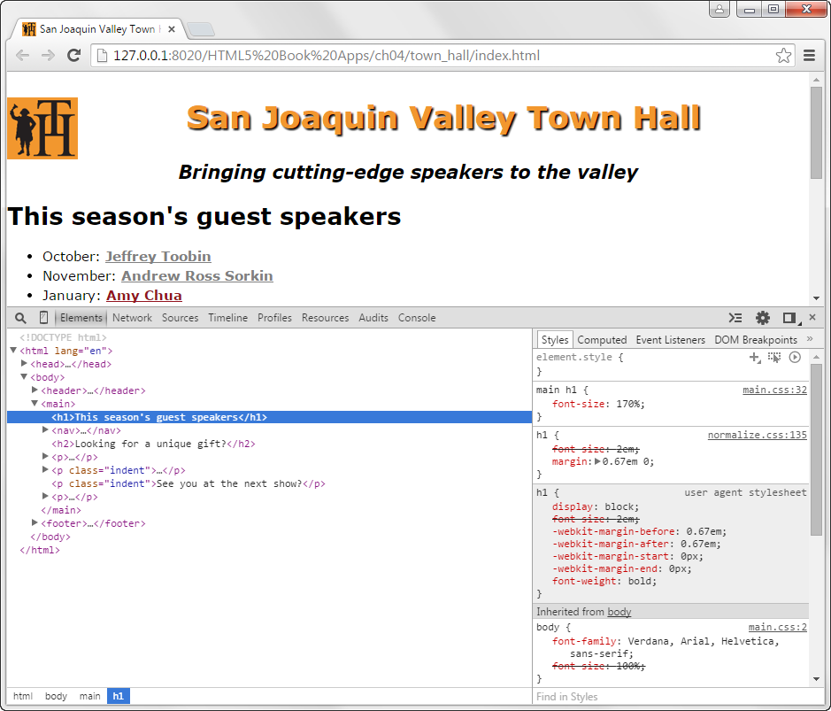
Cascading styles in Chrome’s developer tools

Slide 39
How to use Chrome’s developer tools
To display the panel for the tools, press the F12 key.
To inspect the styles that have been applied to an element, click on the element in the Elements pane at the left side of the developer tools panel.
The styles that have been applied to the selected element are displayed in the Styles pane at the right side of the developer tools panel.

Slide 40
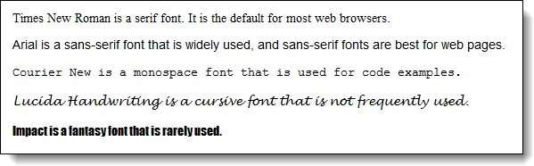
The five generic font families
serif
sans-serif
monospace
cursive
fantasy

Slide 41
How to specify a font family and font size
Font family
font-family: Arial, Helvetica, sans-serif;
font-family: 'Times New Roman', Times, serif;
font-family: 'Courier New', Courier, monospace;
Font size
font-size: 12pt; /* in points */
font-size: 150%; /* as a percent of the parent element */
font-size: 1.5em; /* same as 150% */
Notes
Fonts are searched in the order listed
If the font name includes spaces, the name must be enclosed in quotes.
If generic font family is specified last, the browser will fallback to a default font.
All font properties are inherited by descendants.

Slide 42
A rule for the body element that is inherited by all descendants
body {
font-family: Arial, Helvetica, sans-serif;
font-size: 100%;
}
A rule for a descendent which overrides the inherited font family
p { font-family: 'Times New Roman', Times, serif; }

Slide 43
Other properties for styling fonts
font-style
font-weight
font-variant
line-height
determines how a font is slanted: normal, italic, or oblique
keyword or number that determines boldness of font: normal, bold, bolder, lighter, or number 100 to 900
see https://developer.mozilla.org/en-US/docs/Web/CSS/font-variant
a measurement that specifies the vertical height of each line

Slide 44
How to use the other properties for styling fonts
With font styles and variants
font-style: italic;
font-style: normal; /* remove style */
font-variant: small-caps;
With specify font weights
font-weight: 700;
font-weight: bold; /* same as 700 */
font-weight: normal; /* same as 400 */
font-weight: lighter; /* relative to the parent element */
With line heights
line-height: 14pt;
line-height: 140%;
line-height: 1.4em; /* same as 140% */
line-height: 1.4; /* same as 140% and 1.4em */

Slide 45
The shorthand font property
font: [style] [weight] [variant] size[/line-height] family;
How to use the shorthand font property
font: italic bold 14px/19px Arial, sans-serif;
font: small-caps 150% "Times New Roman", Times, serif;
font: 90%/120% "Comic Sans MS", Impact, sans-serif;
size and family are required, the rest are optional

Slide 46
Properties for indenting, aligning, and decorating text
text-indent
text-align
vertical-align
text-decoration
A measurement that determines the indentation for the first line of text.
Determines the horizontal alignment of text: left, center, right
Determines the vertical aligment of text: bottom, middle, baseline, top
Determines special decorations that are applied to text: underline, overline, line-through, none

Slide 47
The HTML for a web page that will use text indent and horizontal alignment
<header>
<h1>San Joaquin Valley Town Hall</h1>
</header>
<main>
<p>Welcome to San Joaquin Valley Town Hall. We have some fascinating speakers for you this season!</p>
</main>
<footer>
<p>&copy; Copyright 2018 San Joaquin Valley Town Hall.</p>
</footer>
book_examples/ch04/14_indent_align.html

Slide 48
CSS that specifies a text indent and horizontal alignment
body {
font-size: 100%;
margin: 2em;
}
h1 {
font-size: 180%;
}
main p {
text-indent: 2em;
}
footer p {
font-size: 80%;
text-align: right;
}
book_examples/ch04/14_indent_align.html

Slide 49

The formatted HTML in a web browser
book_examples/ch04/14_indent_align.html

Slide 50

The text-shadow property
text-shadow: horizontalOffset, verticalOffset, blurRadius, shadowColor;
A text shadow with no blur or color
The h1 element
<h1>San Joaquin Valley Town Hall</h1>
The CSS
h1 {
color: #ef9c00;
text-shadow: 4px 4px;
}
book_examples/ch04/15_text_shadow.html

Slide 51

A text shadow with blur and color
The h1 element
<h1>San Joaquin Valley Town Hall</h1>
The CSS
h1 {
color: blue;
text-shadow: -2px -2px 4px red;
}
book_examples/ch04/15_text_shadow.html

Slide 52

Accessibility guideline for shadows
Remember the visually-impaired. Too much shadow or blur makes text harder to read.
Shadows should generally be a dark color, preferably black.
Be consistent with the direction of your shadows.
book_examples/ch04/15_text_shadow.html

Slide 53

An image that has been floated to the left of the headings that follow
book_examples/ch04/16_float_image.html

Slide 54
The HTML and CSS for the floated image
The HTML
<img src="images/logo.gif" alt="Town Hall Logo" width="80">
<h1>San Joaquin Valley Town Hall</h1>
<h2>Bringing cutting-edge speakers to the valley</h2>
The CSS
img {
float: left;
margin-right: 1em;
}
The property that will stop the floating
main {
clear: both;
}
book_examples/ch04/16_float_image.html

Slide 55
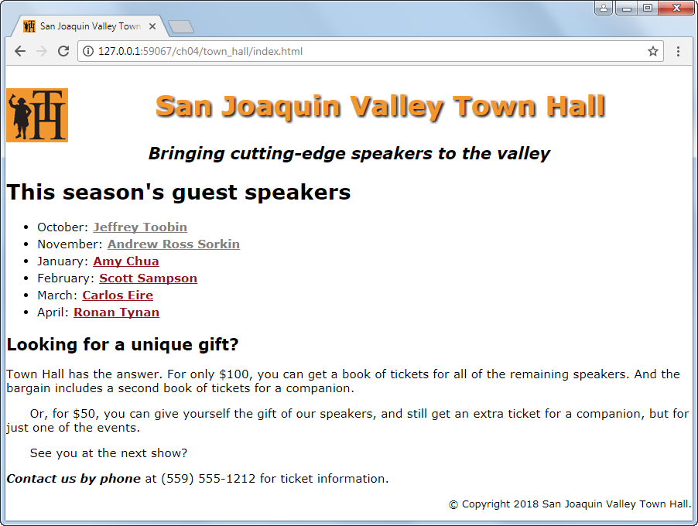
A web page that uses the styles of this chapter
book_apps/ch04/town_hall

Slide 56
The HTML file for the web page (part 1)
<!DOCTYPE HTML>
<html lang="en">
<head>
<title>San Joaquin Valley Town Hall</title>
<meta charset="utf-8">
<link rel="shortcut icon" href="images/favicon.ico">
<link rel="stylesheet" href="styles/normalize.css">
<link rel="stylesheet" href="styles/main.css">
</head>
<body>
<header>
<img src="images/logo.gif" alt="Town Hall Logo" width="80">
<h2>San Joaquin Valley Town Hall</h2>
<h3>Bringing cutting-edge speakers to the valley</h3>
</header>
book_apps/ch04/town_hall

Slide 57
The HTML file for the web page (part 2)
<main>
<h1>This season's guest speakers</h1>
<nav>
<ul>
<li>October: <a class="date_passed"
href="speakers/toobin.html"> Jeffrey Toobin</a></li>
<li>November: <a class="date_passed"
href="speakers/sorkin.html">Andrew Ross Sorkin</a></li>
<li>January: <a href="speakers/chua.html">
Amy Chua</a></li>
<li>February: <a href="speakers/sampson.html">
Scott Sampson</a></li>
<li>March: <a href="speakers/eire.html">
Carlos Eire</a></li>
<li>April: <a href="speakers/tynan.html">
Ronan Tynan</a></li>
</ul>
</nav>
book_apps/ch04/town_hall

Slide 58
The HTML file for the web page (part 3)
<h2>Looking for a unique gift?</h2>
<p>Town Hall has the answer. For only $100, you can get a book of tickets for all of the remaining speakers. And the bargain includes a second book of tickets for a companion.</p>
<p class="indent">Or, for $50, you can give yourself the gift of our speakers, and still get an extra ticket for a companion, but for just one of the events.</p>
<p class="indent">See you at the next show?</p>
<p><em>Contact us by phone</em> at (559) 555-1212 for ticket
information.</p>
</main>
<footer>
<p>&copy; Copyright 2018 San Joaquin Valley Town Hall.</p>
</footer>
</body>
</html>
book_apps/ch04/town_hall

Slide 59
The CSS file for the web page (part 1)
body {
font-family: Verdana, Arial, Helvetica, sans-serif;
font-size: 100%;
}
a { font-weight: bold; }
a:link { color: #931420; }
a:visited { color: #f2972e;}
a:hover, a:focus { color: blue; }
ul { line-height: 1.5; }
li, p { font-size: 95%; }
em { font-weight: bold; }
header img { float: left; }
header h2 {
font-size: 220%;
color: #f2972e;
text-align: center;
text-shadow: 2px 2px 2px black;
}
book_apps/ch04/town_hall

Slide 60
The CSS file for the web page (part 2)
header h3 {
font-size: 130%;
font-style: italic;
text-align: center;
}
main { clear: left; }
main h1 { font-size: 170%; }
main h2 { font-size: 130%; }
main p.indent { text-indent: 2em; }
main a.date_passed { color: gray; }
footer p {
font-size: 80%;
text-align: right;
}
book_apps/ch04/town_hall

Slide 61
Objectives
Applied
Given an HTML document, create a CSS style sheet for formatting the web page using any of the types of selectors or rules that are presented in this chapter.
Given an HTML document with one or more CSS style sheets applied to it, use the developer tools in your browser to inspect the styles.
Given a selector in the CSS for an HTML document, describe what the selector applies to.
Knowledge
Describe three ways to include CSS in a web page.
Explain why it’s usually best to use an external style sheet for formatting a page.

Slide 62
Objectives (continued)
Explain the purpose of a normalize.css style sheet.
Distinguish between absolute and relative units of measurement.
Describe three ways to specify color in CSS, and describe how CSS3 expands upon that.
Describe these types of selectors: universal, type, id, class, descendant, child, sibling, pseudo-class, and pseudo-element.
Describe one accessibility guideline for using pseudo-class selectors.
Explain how !important rules and specificity are used in the cascade order for applying style rules.
Describe these properties for styling fonts: font-family, font-style, font-weight, font-size, and line-height.
Describe these properties for formatting text: text-indent, text-align, text-decoration, and text-shadow.

Slide 63
Assignments
Reading assignments on Perusall
Homework and Labs on InsideRanken

